Slide 1
Well, Water!
Predicting the Functionality of Water Wells in Tanzania
or
PechaKucha!
Researching the Retention Rate of the PechaKucha Presentation Style

Slide 2


Two Problems
Finding a project for GA
Keeps me engaged and curious
Make it business relevant
Could I use this at work?

Slide 3



Pump It Up: Data Mining the Water Table
Similar to Kaggle
The Taarifa Platform
Tanzanian Ministry of Water

Slide 4
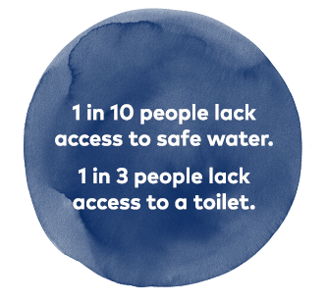
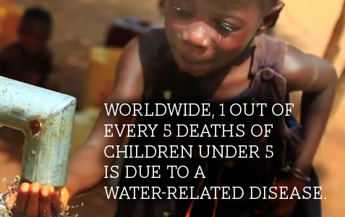
Why is this important, Casey?
The water crisis is the #1 global risk based on impact to society (as a measure of devastation), as announced by the World Economic Forum in January 2015
4% of all official development aid is allocated to the water sector and the total aid share to the water sector is below 6%

Slide 5
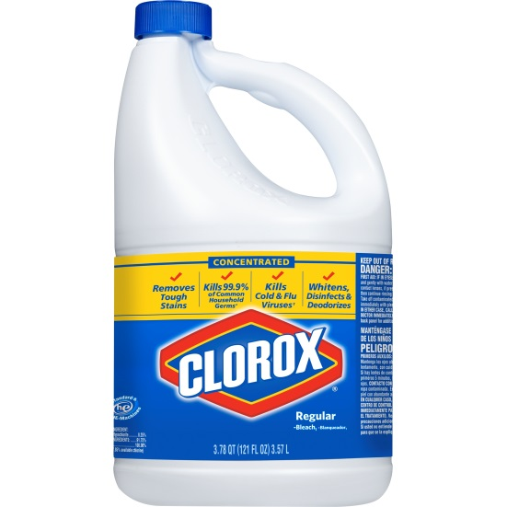

“Make everyday life better, every day.”*
Business relevance:
Two businesses are already actively engaged in water access and sanitation programs worldwide
Peru, Michigan, Red Cross Natural Disaster Relief, etc.
*Disclaimer: Shameless Plug

Slide 6
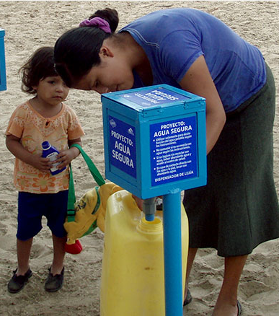
Bleach Blanket Babylon
Low-cost method of water sanitization
Only needs modest resources to introduce program to community
Kills 99% of bacteria and viruses
Continue to sanitize water source for 24 to 48 hours after being added to water
Safe byproducts – breaks down to salt and water

Slide 7
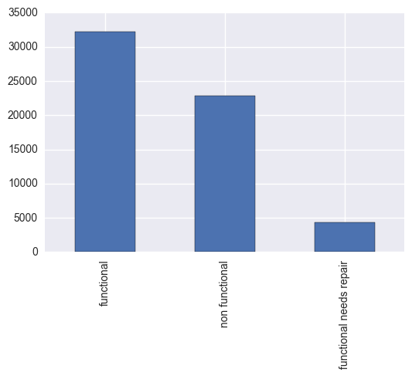
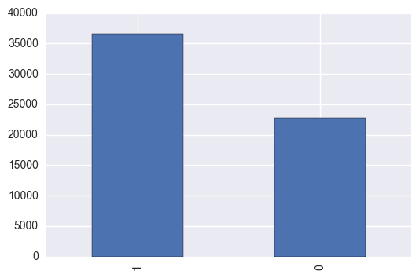
EDA
The goal of the competition was to determine if you could predict if the well was functional, non functional, or functional needs repairs.

Slide 8
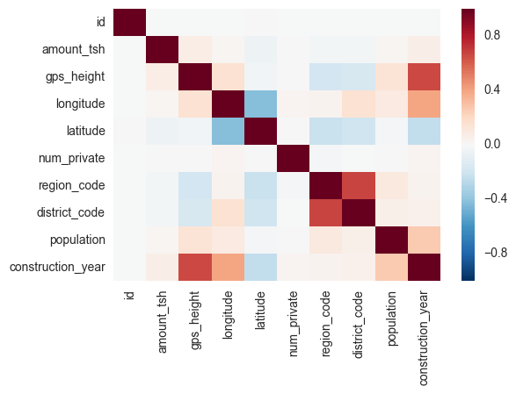
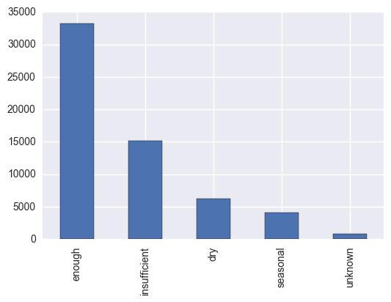
Hot in Herre (Not a typo.)
Not enough information to get an understanding of relationships between values so…

Slide 9
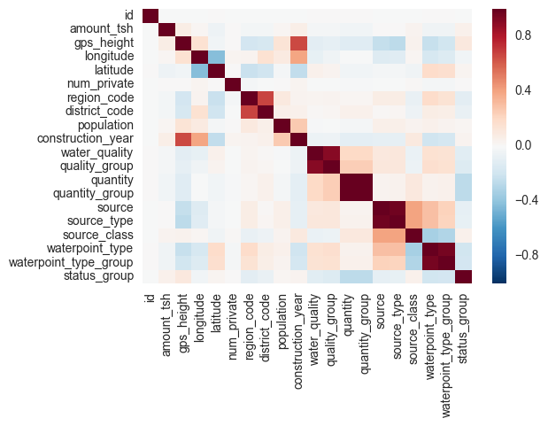
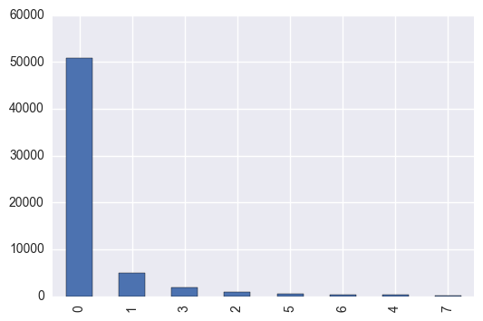
Factorize!

Slide 10
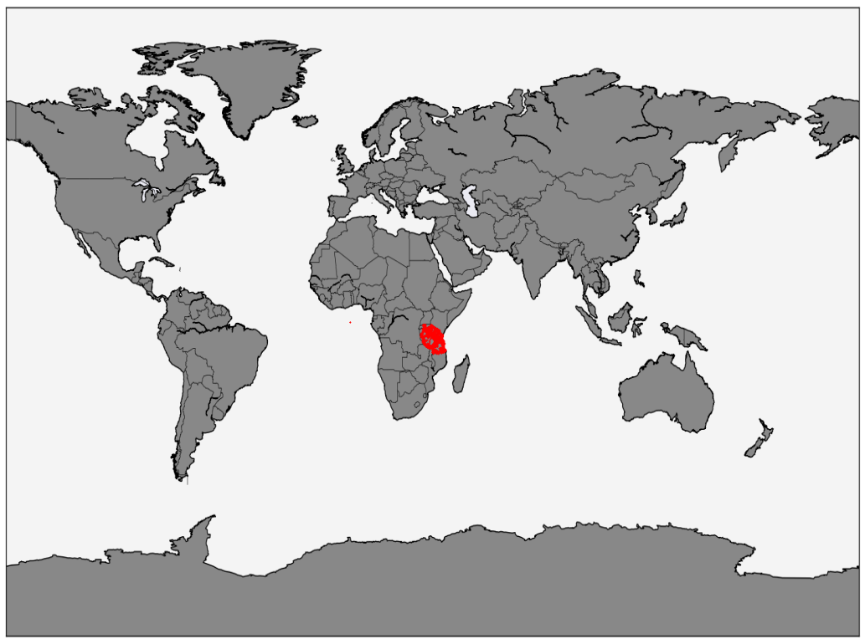
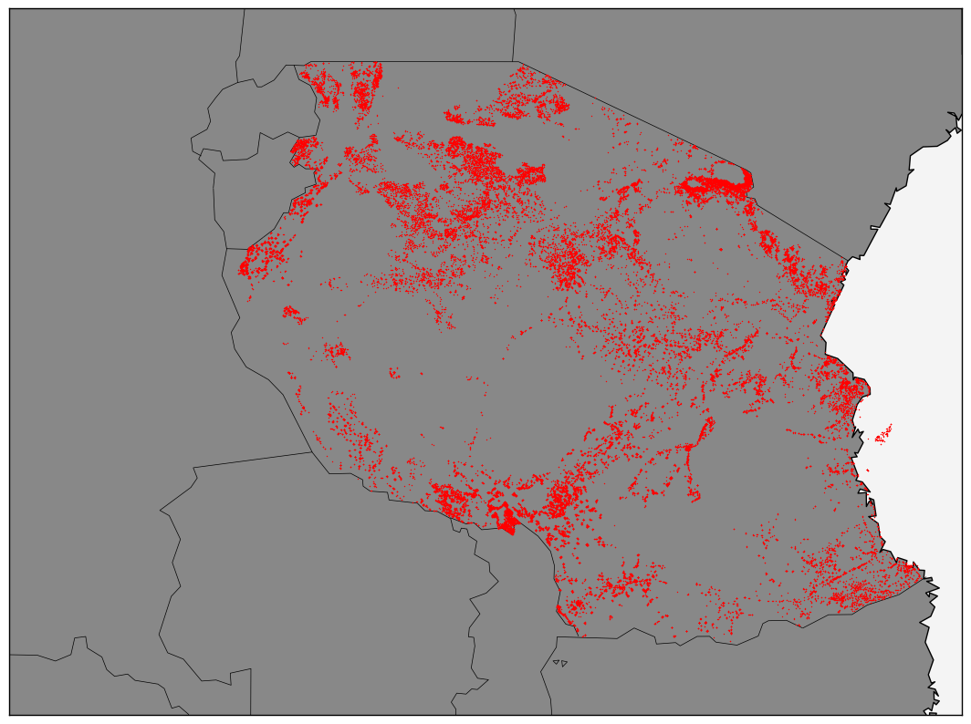
I made a map!
Map created using Basemap in Matplotlib.
Enhance! →

Slide 11
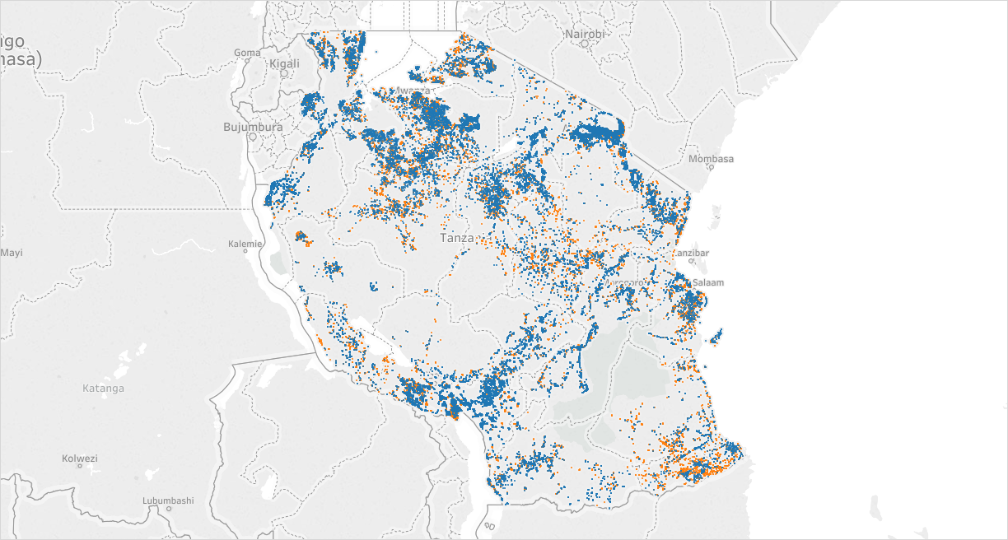
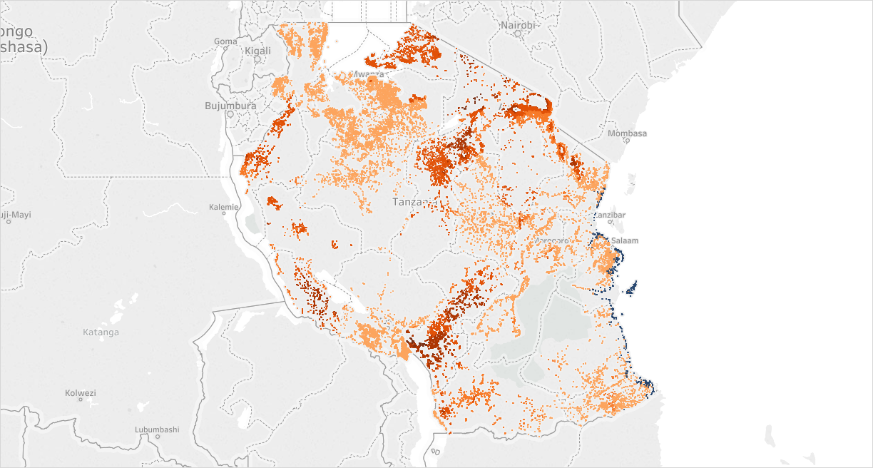
We have the technology!
By Status Group
By GPS Height

Slide 12
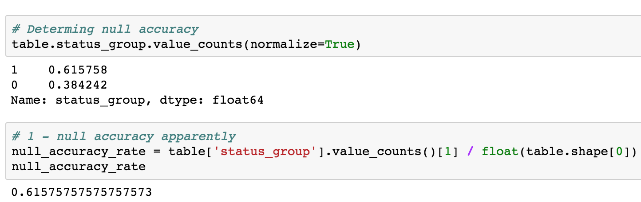

Null Accuracy
61%!
The bar is set relatively low.

Slide 13
Victoria’s Secret
Tested 4 models twice:
KNN
Logistic Regression
Decision Trees
Random Forest
Used two sets of feature columns:
Handpicked
Using EDA

Slide 14
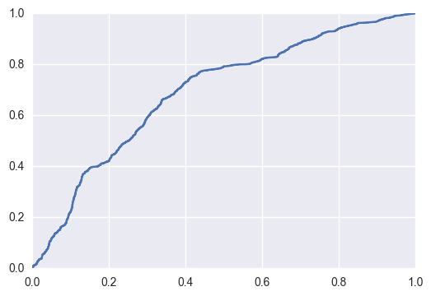
Ensembling - Random Forest
ROC AUC curve
Measured RMSE initially
Whoops!
Need to feature tune to optimize

Slide 15
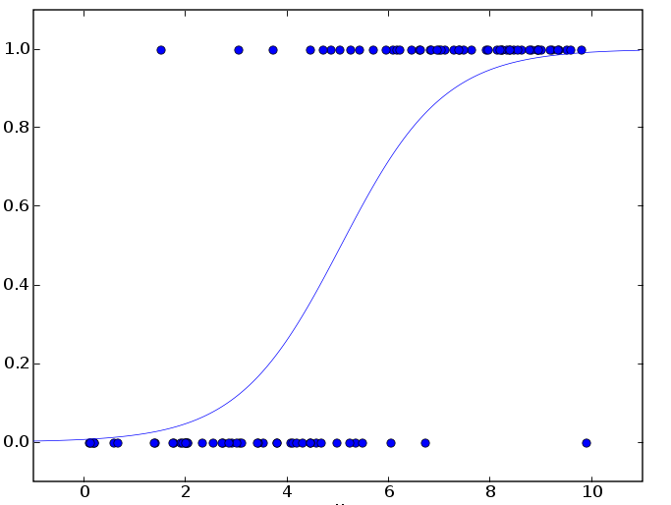
Logistic Regression
I have answers this time!
First Feature Group = 68%
Second Feature Group = 65%

Slide 16

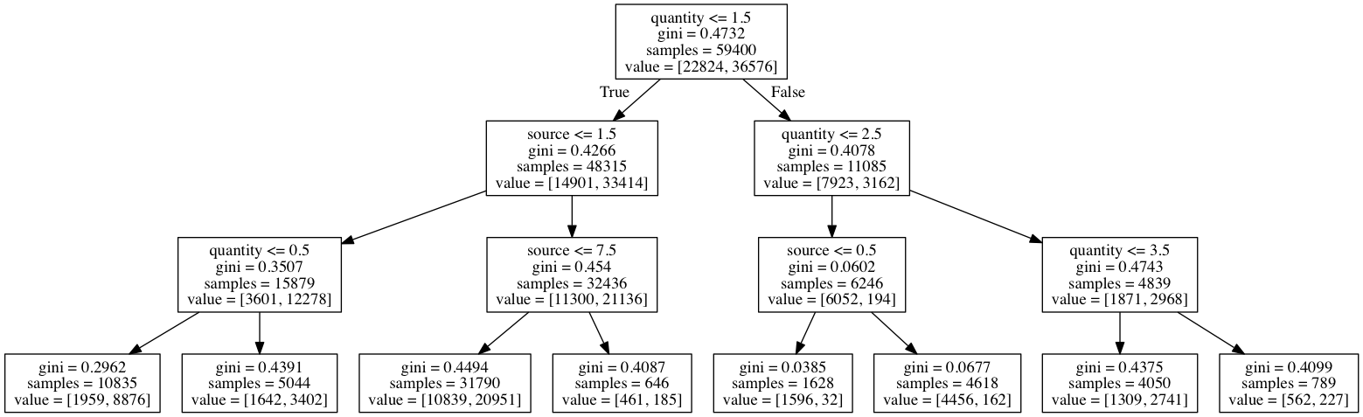
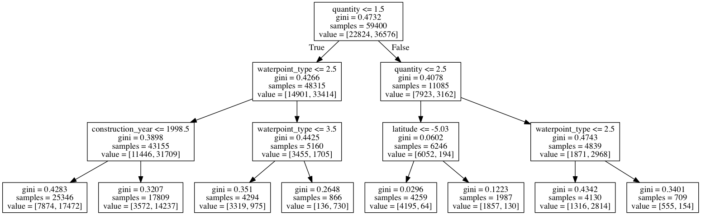
Happy Little Trees

Slide 17

K-Nearest Neighbors
First Feature Group
= 65% (5 Neighbors)
= 74% (3 Neighbors
Second Feature Group
= 81% (5 Neighbors)
= 89% (3 Neighbors

Slide 18
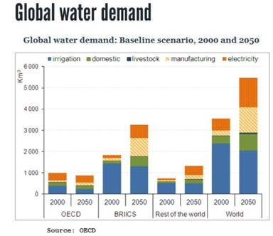

How do we monetize?
Demand for access to safe water is only increasing
No shortage of areas that have similar water access and sanitation issues
Lots of opportunities to use this for similar public works projects as well

Slide 19

What’s next?
Improve the models I built
Test different methods
Cluster Analysis, Voting Classifier, Custom Pipeline, etc.
Explore if there is significance by area (rural vs. urban, etc.) or payment
Build an app to deploy model
Find similar areas/datasets to explore

Slide 20
Thanks for your attention and feel free to reach out: Casey Keenan cpkeenan15@gmail.com
Questions?

